Slide 1

MIS 547
Cloud Computing

Slide 2
AGENDA
What’s covered in this lecture
Agenda
Introduction to Cloud Native
What is Cloud Native
Key Cloud Native Technologies
Open-Source Software and Cloud Native
Setting the scene…

Slide 3
Lecture 10
Cloud Native

Slide 4
Key Ideas from Earlier this Semester
Vertical vs. Horizontal Scaling
Elasticity
Resiliency
Availability
Dependencies

Slide 5
Setting the Scene

Slide 6
Our Current Tech landscape
Web-scale
Millions of transactions, millions of customers
Global
Peak time somewhere in the world all the time
No good time for downtime
Customer-facing
Iterate continuously on new features and improvements
Changes are infinite sources of failures and faults

Slide 7
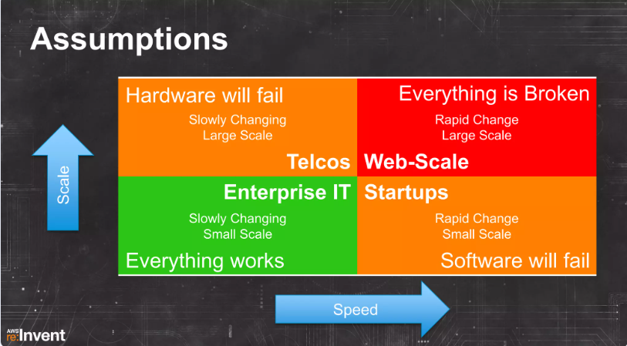
Our Current Tech Landscape

Slide 8

Netflix, Circa 2008:
Goals:
Performance
Scale
Availability

Slide 9
Netflix, Circa 2008
Performance:
Reduce session start by 1s; save 1 human lifetime per day
Suggest choices 1% better: 500k hours/day additional value delivered
Scale:
50% year over year traffic growth (as of 2013)
50 countries, 3 continents (as of 2013)
10Ks instances at peak
4 AWS regions, 12 datacenters
$0.01 per start

Slide 10
Netflix, Circa 2008
Availability:
Aspire to 4x 9s (99.99% of starts successful)
Less than 3 minutes per quarter of downtime
If there are 1T starts per quarter, at 99.99% availability…
Successful starts: 9.999B
Failed starts: 1M
1M failed starts → frustration, lost business, customer support calls, etc.

Slide 11
Availability Conversions
Availability % | Downtime per year
90% (“one nine”) | 36.5 days
99% (“two nines”) | 3.65 days
99.9% (“three nines”) | 8.76 hours
99.99% (”four nines”) | 52.56 minutes
99.999% (“five nines”) | 5.26 minutes
AWS EC2
Emergency response systems

Slide 12
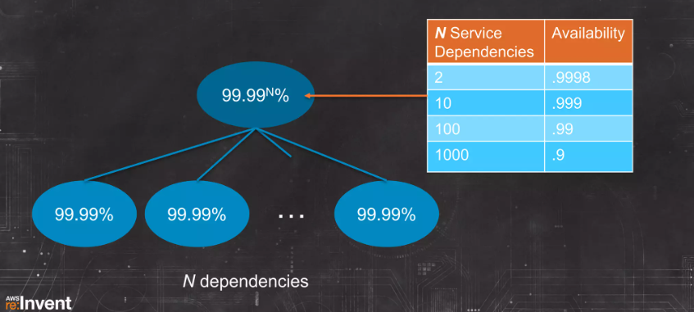
Compounding Availabilities
52.56 minutes downtime/year
8.75 hours downtime/year
3.65 days downtime/year
36.5 days downtime/year
Source: AWS ReInvent 2013

Slide 13
Availabilities Compound
6 nines (99.9999%) availability for each dependency
One component failure leads to system failure
Isolation for independence
Component failure leads to degradation rather than system failure
To achieve 99.99% availability with 1000 components requires either:
Notes:
6 nines of availability:
Car will start every morning and every evening for 1700 years

Slide 14
Rapid Iteration and Rate of Change
Running tests, adding features, removing features
Up to 1,000 changes per day
Availability is in tension with rate of change because
Change leads to bugs

Slide 15

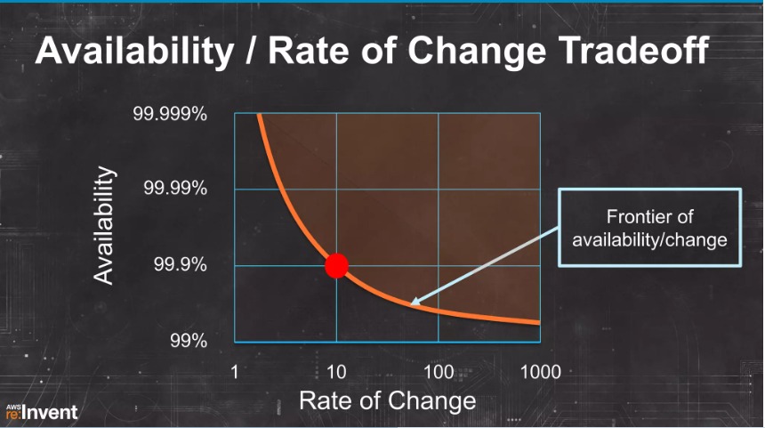
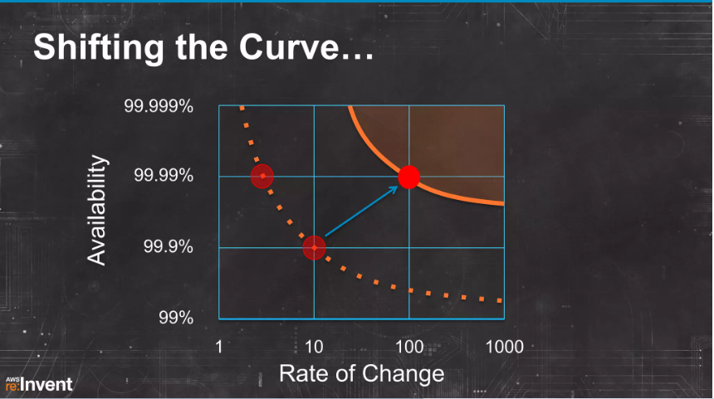
Rapid Iteration and Rate of Change
Source: AWS ReInvent 2013

Slide 16
How To Allow for Availability and Rapid Change?
Rethink the architectural approach.
Subsystem isolation: failure in one component should never result in cascading system failure.
Break chained dependencies
Redundant systems
Failover with timeout
Timeout with default response

Slide 17
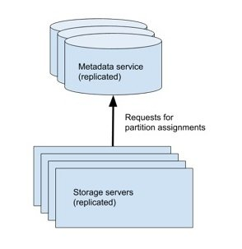
Cascading System Failure
Amazon DynamoDB US-East-1 on September 20, 2015
Two subsystems: storage servers, metadata service
Storage servers request data partition assignments from the metadata service
New index type (Global Secondary Indexes) increased average time of response, but capacity of metadata service hadn’t been increased
Request timeout periods hadn’t been adjusted
Any request that didn’t succeed within a deadline was considered to have failed and client would retry

Slide 18
Cascading System Failure
Storage servers that did not receive assignments removed themselves from service
Continued to retry their requests for partition assignment
Metadata servers overwhelmed with load from these requests
Slower to respond
More timeouts
More retries
More load
Metadata servers so badly overloaded that they had to be firewalled off from storage servers to add extra capacity
Took DynamoDB offline in US-East-1 for 4 hours

Slide 19
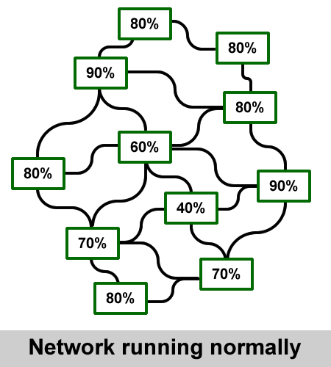
Cascading system failure

Slide 20
What Is Cloud Native?

Slide 21
Definition of Cloud Native
“Cloud native technologies empower organizations to build and run scalable applications in modern, dynamic environments such as public, private, and hybrid clouds. Containers, service meshes, microservices, immutable infrastructure, and declarative APIs exemplify this approach.
These technologies enable loosely coupled systems that are resilient, manageable, and observable. Combined with robust automation, they allow engineers to make high-impact changes frequently and predictably with minimal toil.”
-Cloud Native Computing Foundation (CNCF) Cloud Native Definition v1.0

Slide 22
Cloud-Enabled vs. Cloud-Native Applications
Cloud enabled: legacy enterprise applications that were running on an on-prem data center but have been modified to run on the cloud.
Cloud-native refers to an application that was designed to reside in the cloud from the start. Cloud native involves cloud technologies like microservices, container orchestrators, and auto scaling.

Slide 23
Cloud Native: The How
Key Technologies behind cloud native applications

Slide 24
Cloud Native Application Architecture
Immutable infrastructure
Microservices
API
Service mesh
Containers

Slide 25
Cloud Native Application Development
CI/CD
Containers
DevOps
Execution Environment

Slide 26
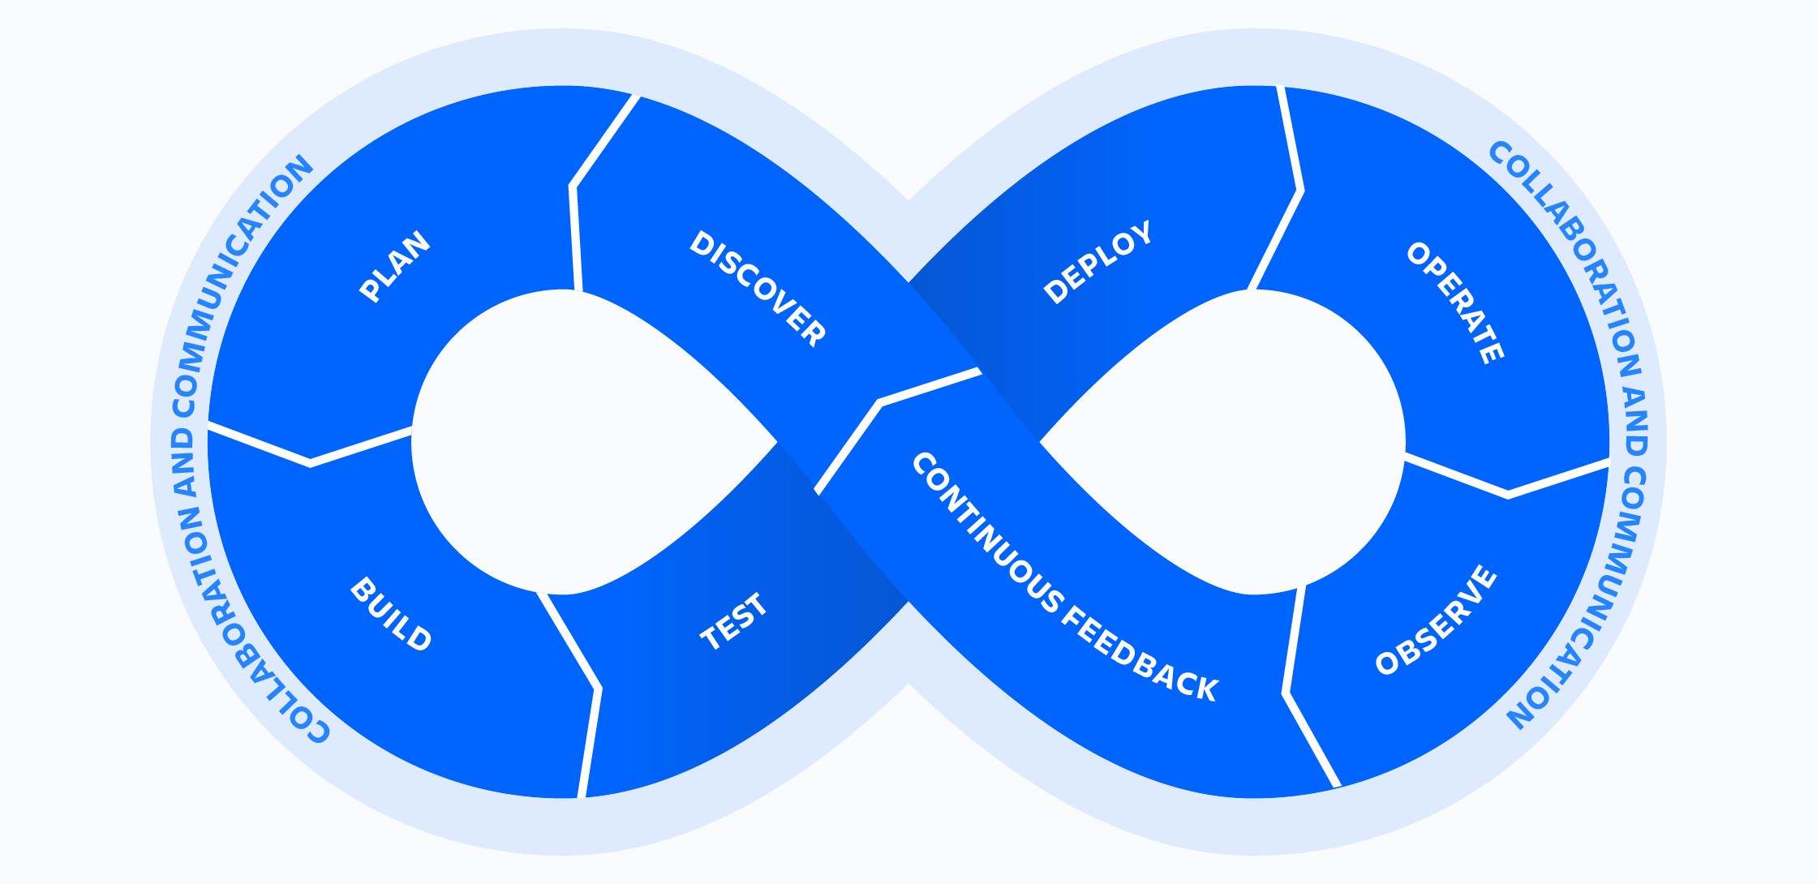
DevOps
Benefits of DevOps:
Improved collaboration
Rapid deployment
Quality and reliability
Security
DevSecOps
Processes, capabilities and tools for Development (left side) and operations (right side)

Slide 27
What Makes Cloud Native work?
Automation: CI/CD, Orchestration, Observability
Focus on the application and not the infrastructure: Containers
Understand and apply new patterns and tools: Microservices

Slide 28
Automation ABCDE
App is developed and tested locally
Built automatically using CI of choice
Container image pushed automatically
Deployed automatically using deployment service
To an Execution Environment of your choice

Slide 29
Cloud Native Patterns
Microservices and Microliths
Robots not pets
Observability and control baked in
Traffic patterns: Blue/Green, Smart Routing, Load Balancing

Slide 30
Distributed Systems
A key characteristic of cloud-native applications is that they are comprised of many small services that comprise a whole (microservices).
These services are not on the same machine but need to function as one application.
A distributed system is a system in which individual computers are connected through a network and appear as a single computer.

Slide 31
Distributed System Challenges
The network is not reliable
Latency is non-zero
Bandwidth is finite
The network is not secure
The topology is always changing
There can be as many administrators as services
Transport cost is non-zero
The network is heterogeneous

Slide 32
The Twelve-Factor App Methodology
One codebase tracked in version control; many deploys
Explicitly declare and isolate dependencies
Store configuration in the environment (separate from code)
Treat backing services as attached resources (e.g. managed caching service or DBaaS)
Strictly separate build and run stages
Execute the app in one or more stateless processes (data should only be saved outside the process)

Slide 33
The Twelve—Factor App, cont.
7. Each service manages its own data.
8. Scale out via the process model.
9. Maximize robustness with fast startup and graceful shutdown
10. Keep development, staging, and production as similar as possible.
11. Treat logs as event streams.
12. Run admin and management tasks as one-off processes.

Slide 34
Cloud Native: The How
Business cases

Slide 35
How does Cloud-Native Benefit Business?
Increase efficiency
Reduce cost
Ensure availability

Slide 36
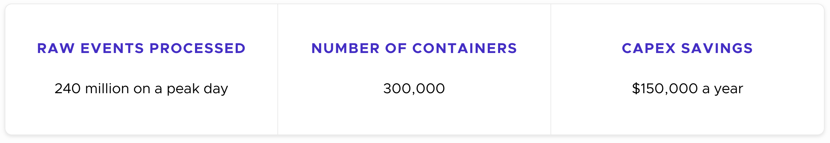
Business Use Cases
Frame.io Security Program using Falco (container runtime security)

Slide 37
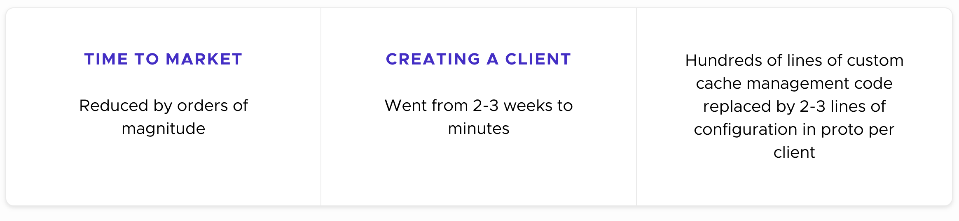
Business Use Cases
Netflix scales interservice communications across languages, clouds, and datacenters and with gRPC

Slide 38
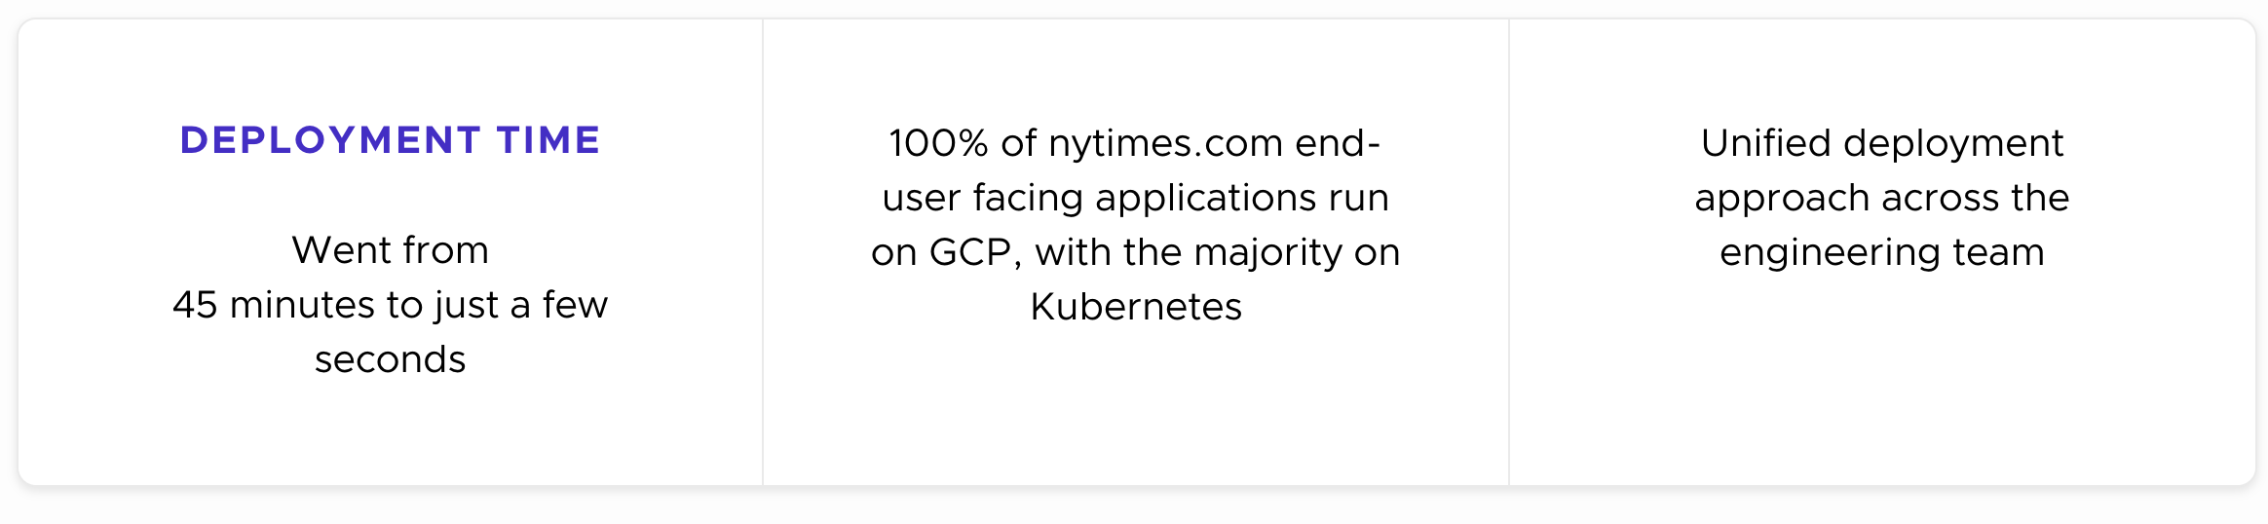
Business Use Cases
The New York Times refactors traditional cloud applications to Cloud Native using Google Cloud Platform Kubernetes Engine (GKE)

Slide 39
Cloud Native: The Who
CNCF, Linux Foundation, and the Open Source World

Slide 40

The Linux Foundation
Safeguards Linux for the long term
Provides nexus for collaboration and trust
Ubiquitous open-source brand
Good for customers and the community

Slide 41

Cloud Native Computing Foundation (CNCF)
A foundation dedicated to promoting and supporting open-source cloud computing for applications, not infrastructure.
Support Cloud Native architectural patterns:
Patterns require good software, tools you can trust
Kubernetes
Prometheus
Linkerd
gRPC
Sooooo many more

Slide 42
Open-Source Software and Cloud Native
Why is OSS so important?
No vendor lock-in
Choose the best tool from a diverse range of projects without being tied to a single provider
Greater flexibility
Community-driven development
Faster bug fixes, new features, better overall quality
Transparency and security
Cost-effectiveness
Interoperability
Standards and APIs enable smooth integration between different cloud services and applications
Customization
Modify and adapt OSS as needed
Examine software for security vulns
Free to use, eliminating licensing costs

Slide 43
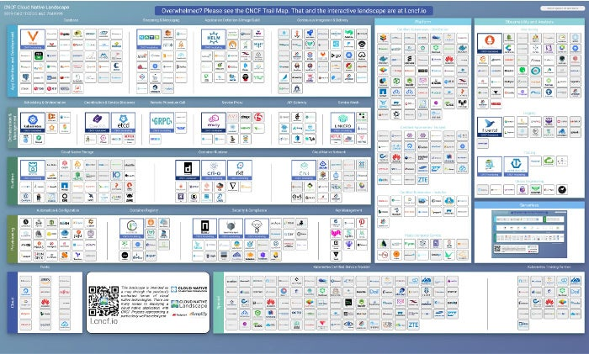
The CNCF Landscape

Slide 44
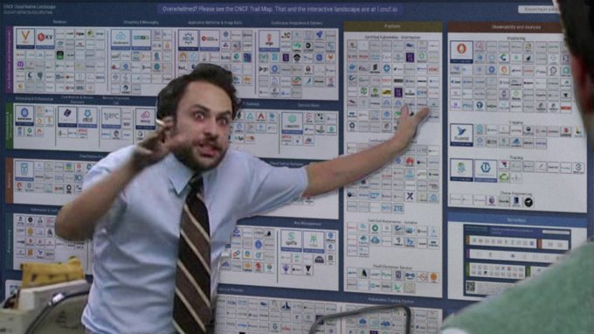

Slide 45
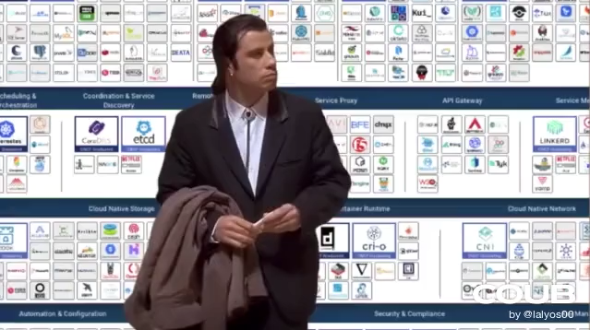

Slide 46
Land Acknowledgement Statement
We respectfully acknowledge the University of Arizona is on the land and territories of Indigenous peoples. Today, Arizona is home to 22 federally-recognized tribes, with Tucson being home to the O’odham and the Yacqui. Committed to diversity and inclusion, the University strives to build sustainable relationships with sovereign Native Nations and Indigenous communities through education offerings, partnerships, and community service.

